Slide 1
EMPOWERING LOCAL GOVERNMENT SUCCESS
MRSC’s Services
July 11, 2019

Slide 2
Overview
Our Mission.
Trusted guidance and services supporting local government success.

Slide 3
Overview
MRSC:
Was established in 1934, has served local governments in WA for 85 years
Educates and informs on legal, policy, and finance issues
Provides independent, nonpartisan research & guidance
Does not lobby
Does not take sides on policy issues or disputes
Does not provide legal representation or serve as legal counsel

Slide 4
MRSC by the Numbers
In 2018:
6,300+ people asked us for one-on-one guidance
8,600+ people attended MRSC trainings
22,000+ people subscribed to our e-newsletters
1.8 million people visited our website resources

Slide 5
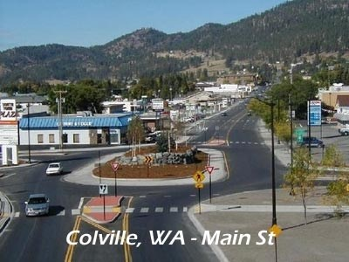
MRSC Core Areas
Budgeting and Revenue guidance
Governing Body Procedures
Public Works/Bidding
Personnel Policies
Land Use and Planning
Public Records guidance

Slide 6
MRSC Emerging Issue Areas
Small Cell Wireless Facilities
Homelessness
Cybersecurity
Drones
Marijuana

Slide 7
How important are our services?

Slide 8
Overall user satisfaction

Slide 9
MRSC Consultant Staff
Legal Consultants (Attorneys)
Flannary Collins
Sarah Doar
Jill Dvorkin
Linda Gallagher
Moses Garcia
Oskar Rey
Paul Sullivan
Policy/Finance Consultants
Steve Butler, Planning
Mike Bailey, Finance
Laura Crandall, Public Policy & Finance
Judy Isaac, Public Works & Procurement
Byron Katsuyama, Public Policy/Management
Toni Nelson, Finance
Behind the Scenes: Admin, Communications, IT

Slide 10
What MRSC Users Are Saying
The MRSC website is one of the most valuable tools that is available to our City employees.
Please keep up the good work and don’t ever stop. Your website, staff and resources are more valuable than you can imagine to smaller units of government.
I have never been dissatisfied with your service (which is not to say I always liked the answer I got, but that just goes to show that your folks are unbiased).
I’ve used MRSC resources for 18 years and absolutely love what you do. Your people are the best!

Slide 11
What MRSC Users Are Saying
I used MRSC for information about the new marijuana excise tax laws passed last year. If not for this, our office would not have been aware of nearly $2 million in revenues available intended for enforcement
Without MRSC it would take a great deal more attorney time and staff time to research subjects and past history. In all likelihood, our decisions would be less thorough and defensible.
Losing MRSC would impact the breadth of research that staff can do. Research would not happen or would require much more staff time.
It would be devastating to lose MRSC, especially to small cities with limited and diminishing resources. It would be like trying to conduct commerce in this age without the internet.
DeWayne Pitts
Vicky Dalton
Jay Arnold
Jason Walker
King County Chief Financial Officer
Spokane County Auditor
Kirkland Deputy Mayor
Duvall City Councilmember

Slide 12
MRSC Website Overview
Our website contains:
Databases – City/County Profiles, Local Ballot Measures
~420 “topic pages” with legal/policy guidance
Over 3,600 sample documents
2-3 new blog posts per week
Webinars & trainings
Publications
…just to name a few!

Slide 13
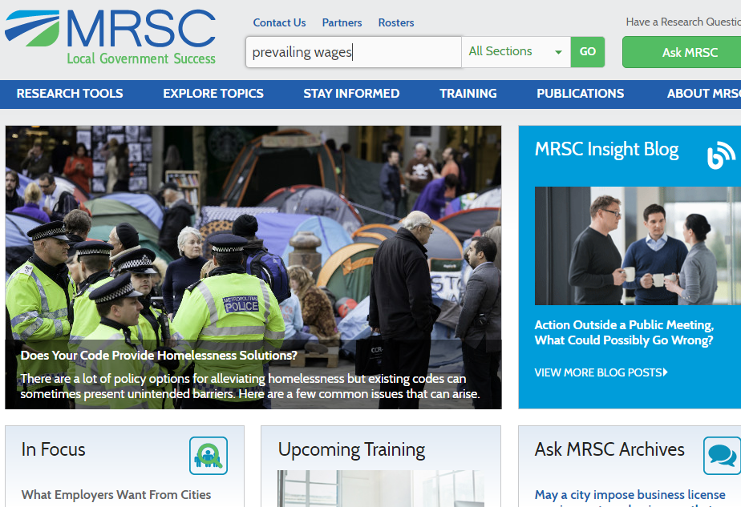
Website Search
Good place to start if you’re looking for info but don’t know where to find it
Simple search terms (prevailing wages) are better than complex terms

Slide 14
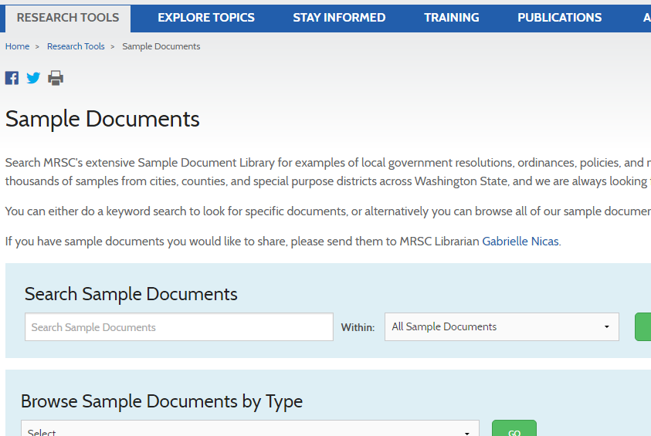
Sample Document Library
Under “Research Tools”
Search over 3,600:
Policies/procedures
Ordinances/resolutions
Sample job descriptions
Contracts
RFPs/Bidding Documents
And more!

Slide 15
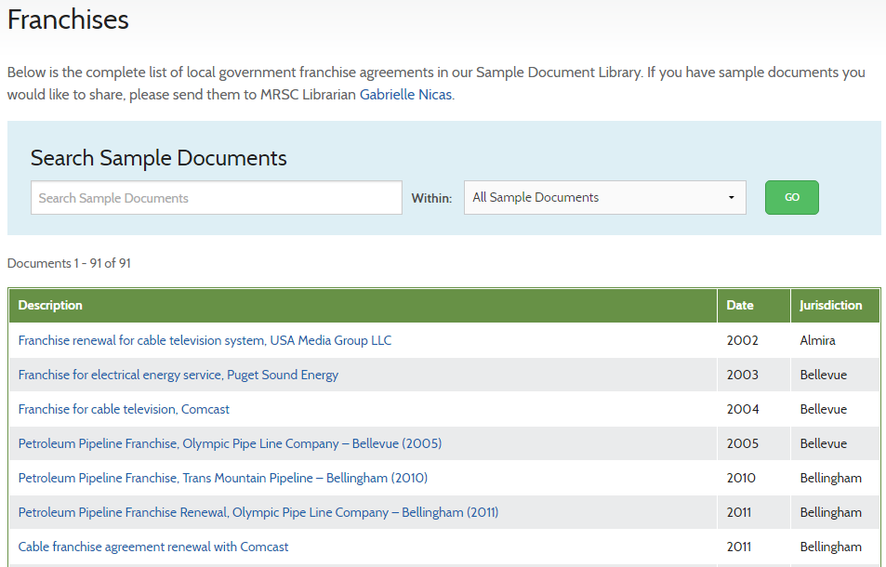
Sample Document Library
Can browse all documents in a section…

Slide 16
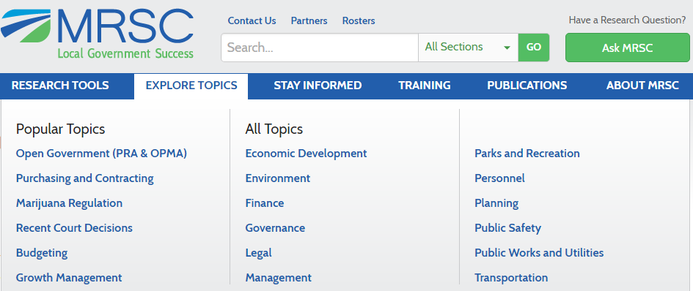
Explore Topics
Get legal analysis, policy guidance, sample documents, and more
≈ 420 topics
“Popular Topics” category

Slide 17
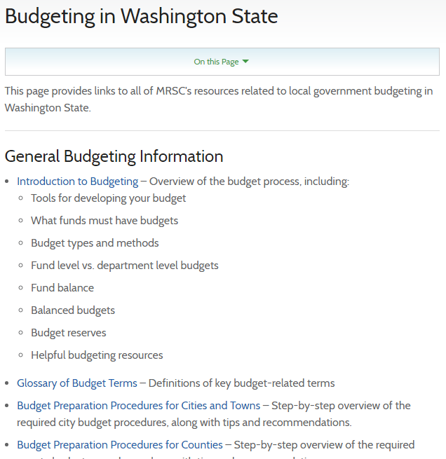
Explore Topics – “Popular Topics”
“One-stop shop” for:
PRA/OPMA
Purchasing & contracting
Marijuana regulation
Court decisions
Budgeting
GMA
Includes links to all related MRSC materials (topic pages, publications, blog posts, etc.)

Slide 18
Have a Question? Ask MRSC!
Call or submit your question online. We’ll get back to you fast!
Free for eligible agencies
All cities/counties
Hundreds of special purpose districts
Other government partners

Slide 19
Ask MRSC
Examples of questions we receive:
How are the five business days calculated in responding to public record requests?
Is there a conflict of interest if a fire district commissioner marries a fire district employee?
Is it legal for a county to pay a “signing bonus” to a new employee?
Can you send me examples of short-term rental (Airbnb) ordinances from small cities that authorize the city to collect permit fees?

Slide 20
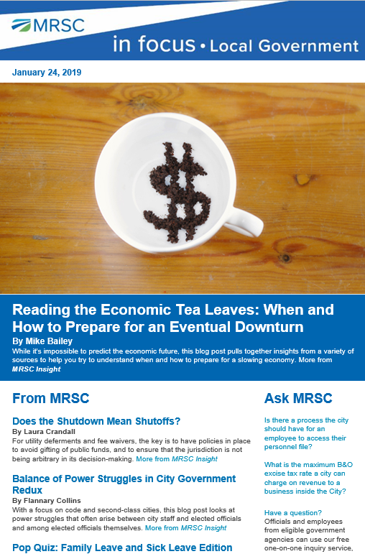
MRSC E-Newsletters
The latest local government news and analysis
Sign up and get:
Blog posts / analysis
News headlines / links
Upcoming trainings
Announcements
Mobile-friendly – read on the go!

Slide 21
City & County Revenue Guides
Completely re-written and re-published! Learn about:
Property taxes
Sales taxes
Lodging taxes
Real estate excise taxes
Key considerations for voted and non-voted revenues
And much, much more!

Slide 22
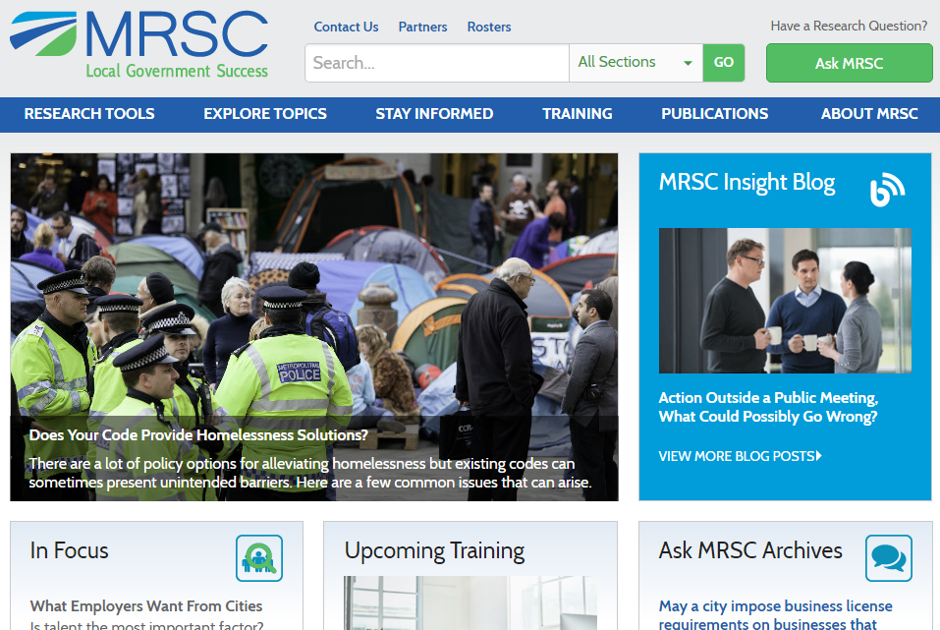
MRSC Training
Monthly webinars
In-person regional trainings
Archived webinars & E-learning

Slide 23
Historical Funding Models
1945–2000
Funded by Motor Vehicle Excise Tax (MVET)
County research mandate added in 1997 funded by liquor excise tax
Municipal Research Council responsible for contracting with MRSC
2000
I-695 repeals MVET, leaving funding gap for MRSC
City portion diverted to liquor revolving fund
County portion unchanged by I-695
2010
MRSC appropriations redirected to Department of Commerce
2012
I-1183 privatizes liquor sales, MRSC funded out of the liquor revolving fund directly
Municipal Research Council eliminated to reduce state costs

Slide 24
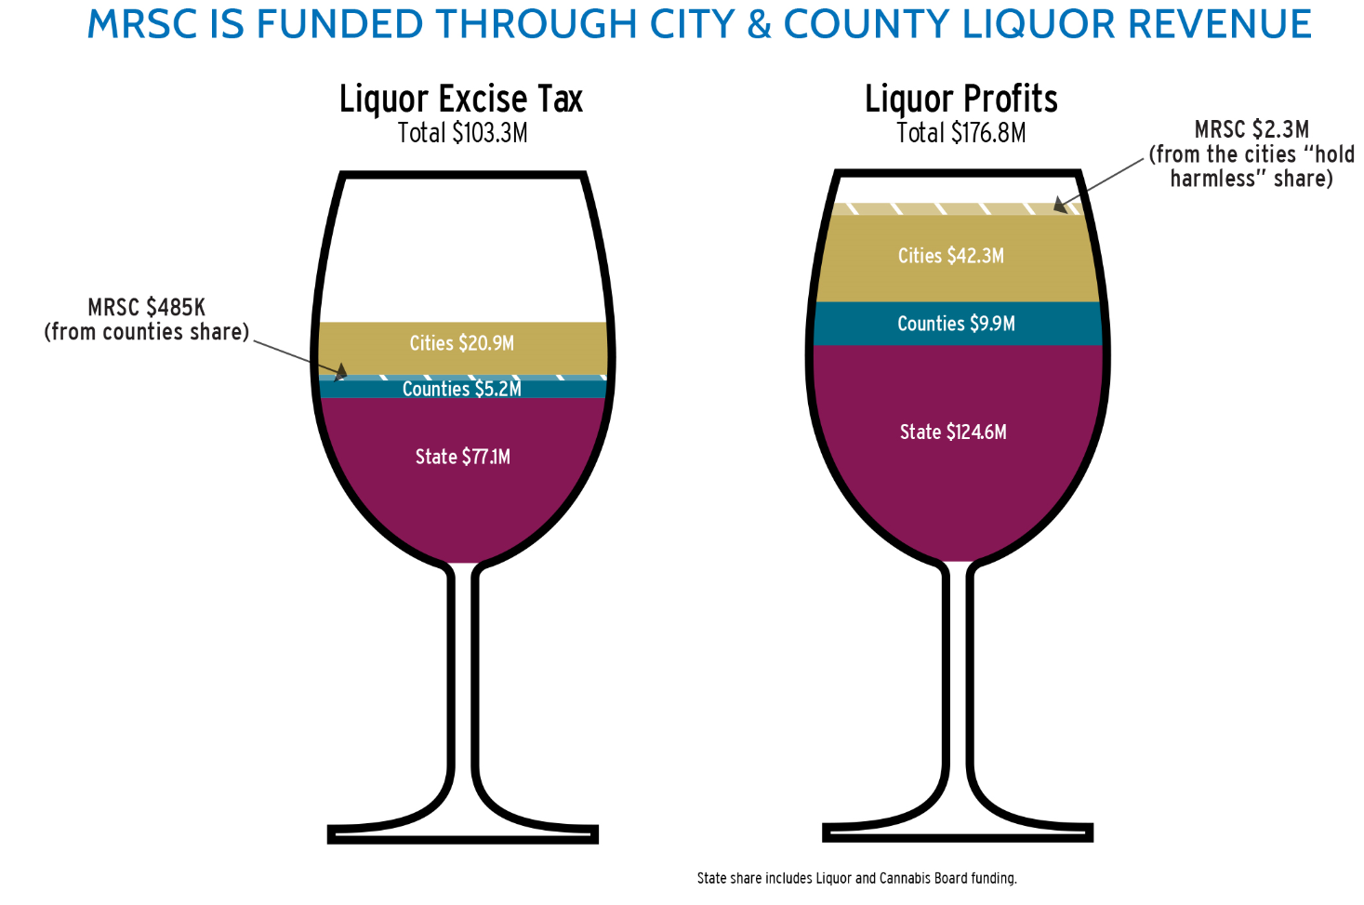
Current Funding Model

Slide 25
MRSC State Appropriations (Real Dollars)
* MRSC Contract line does not include 07-08 $400K SPD funding amounts

Slide 26
Final Thoughts
Be Bold!
Focus on the Customer
Build on Your Strengths
You Can Do This!

